Slide 1
Day5 容器进阶之Kubernetes pod调度原理分析

Slide 2
大 纲
理解资源限制对Pod调度的影响
使用label selector调度Pod
手动调度Pod
理解DaemonSet
调度失败原因分析
使用多调度器
了解调度器的配置

Slide 3
Kubernetes 调度相关基础概念

Slide 4
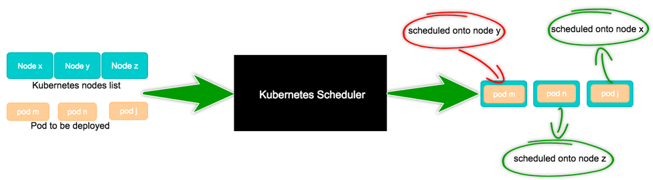
Scheduling：为Pod找到一个合适的Node
apiVersion: v1
kind: Pod
metadata:
name: my-pod-76559f5d5b-l9b9p
......
spec:
dnsPolicy: ClusterFirst
nodeName:
restartPolicy: Always
containers:
......
apiVersion: v1
kind: Pod
metadata:
name: pod-76559f5d5b-l9b9p
......
spec:
dnsPolicy: ClusterFirst
nodeName: node1
restartPolicy: Always
containers:
......

Slide 5
Node 定义
apiVersion: v1
kind: Node
metadata:
labels:
beta.kubernetes.io/arch: amd64
beta.kubernetes.io/os: linux
kubernetes.io/hostname: node-n1
name: node-n1
spec:
externalID: node-n1
status:
addresses:
- address: 10.162.197.135
type: InternalIP
allocatable:
cpu: "8"
memory: 16309412Ki
pods: "110"
capacity:
cpu: "8"
memory: 16411812Ki
pods: "110"
conditions: {...}
daemonEndpoints:
kubeletEndpoint:
Port: 10250
images: {...}
nodeInfo: {...}
执行 kubectl get node <node-name> -o yaml 查看一个完整的node
一个node的可分配资源量

Slide 6
Pod 定义
apiVersion: v1
kind: Pod
metadata:
labels:
run: my-pod
name: my-pod
namespace: default
spec:
containers:
- image: nginx
imagePullPolicy: Always
name: my-pod
ports:
- containerPort: 80
protocol: TCP
resources:
requests:
memory: "10Gi"
cpu: "500m"
limits:
memory: "10Gi"
cpu: "500m"
schedulerName: default-scheduler
nodeName: node-n1
restartPolicy: Always
nodeSelector: {...}
affinity: {...}
tolerations: {...}
status: {}
执行 kubectl explain pod.spec 查看 pod.spec 提供的完整配置字段

Slide 7
Pod 中影响调度的主要属性字段
apiVersion: v1
kind: Pod
metadata:
labels:
run: my-pod
name: my-pod
namespace: default
spec:
containers:
- image: nginx
imagePullPolicy: Always
name: my-pod
ports:
- containerPort: 80
protocol: TCP
resources:
requests:
memory: "10Gi"
cpu: "500m"
limits:
memory: "10Gi"
cpu: "500m"
schedulerName: default-scheduler
nodeName: node-n1
restartPolicy: Always
nodeSelector: {...}
affinity: {...}
tolerations: {...}
status: {}
执行 kubectl explain pod.spec 查看 pod.spec 提供的完整配置字段
资源调度依据
执行调度的调度器
调度结果
高级调度策略

Slide 8
Kubernetes 中的资源分配

Slide 9
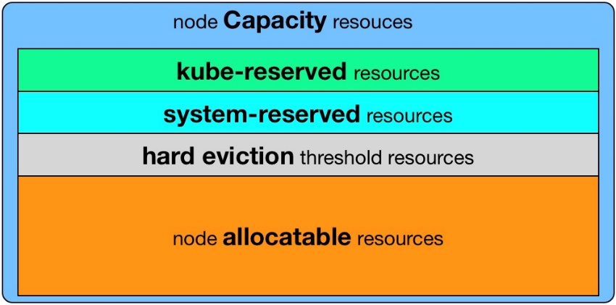
K8S 调度器的资源分配机制
基于Pod中容器request资源“总和”调度
resoureces.limits影响pod的运行资源上限，不影响调度
initContainer取最大值，container取累加值，最后取大者 即 Max( Max(initContainers.requests), Sum(containers.requests) )
未指定request资源时， 按0资源需求进行调度
基于资源声明量的调度，而非实际占用
不依赖监控，系统不会过于敏感
能否调度成功：pod.request < node.allocatable - node.requested
Kubernetes node 资源的盒子模型
资源分配相关算法
GeneralPredicates（主要是PodFitsResources）
LeastRequestedPriority
BalancedResourceAllocation，平衡cpu/mem的消耗比例

Slide 10
Pod 所需资源的计算
apiVersion: v1
kind: Pod
metadata:
name: my-pod
spec:
initContainers:
- name: ic1
resources:
requests:
cpu: "1"
memory: "1G"
- name: ic2
resources:
requests:
cpu: "1"
memory: "3G"
containers:
- name: container1
resources:
requests:
cpu: "500m"
memory: "1G"
- name: container2
resources:
requests:
cpu: "500m"
memory: "1G"
InitContainers：
逐个运行并退出，之后才拉起containers
资源需求取单个容器的最大值
Containers：
同时运行，资源需求为所有容器累加
最终结果：cpu 1，memory 3G

Slide 11
Kubernetes 中的高级调度及用法

Slide 12
nodeSelector：将 Pod 调度到特定的 Node 上
apiVersion: v1
kind: Pod
metadata:
labels:
pod-template-hash: "4173307778"
run: my-pod
name: my-pod
namespace: default
spec:
containers:
- image: nginx
imagePullPolicy: Always
name: my-pod
ports:
- containerPort: 80
protocol: TCP
resources: {}
nodeSelector:
disktype: ssd
node-flavor: s3.large.2
语法格式：map[string]string
作用：
匹配node.labels
排除不包含nodeSelector中指定label的所有node
匹配机制 —— 完全匹配

Slide 13
nodeAffinity：nodeSelector 升级版
与nodeSelector关键差异
引入运算符：In，NotIn （labelselector语法）
支持枚举label可能的取值，如 zone in [az1, az2, az3...]
支持硬性过滤和软性评分
硬性过滤规则支持指定 多条件之间的逻辑或运算
软性评分规则支持 设置条件权重值
apiVersion: v1
kind: Pod
metadata:
name: with-node-affinity
spec:
affinity:
nodeAffinity:
requiredDuringSchedulingIgnoredDuringExecution:
nodeSelectorTerms:
- matchExpressions:
- key: node-flavor
operator: In
values:
- s3.large.2
- s3.large.3
preferredDuringSchedulingIgnoredDuringExecution:
- weight: 1
preference:
matchExpressions:
- key: node-flavor
operator: In
values:
- s3.large.2
containers:
- name: with-node-affinity
image: k8s.gcr.io/pause:2.0
硬性过滤：
排除不具备指定label的node
软性评分：
不具备指定label的node打低分，降低node被选中的几率

Slide 14
podAffinity：让某些 Pod 分布在同一组 Node 上
与nodeAffinity的关键差异
定义在PodSpec中，亲和与反亲和规则具有对称性
labelSelector的匹配对象为Pod
对node分组，依据label-key = topologyKey，每个label-value取值为一组
硬性过滤规则，条件间只有逻辑与运算
apiVersion: v1
kind: Pod
metadata:
name: with-pod-affinity
spec:
affinity:
podAffinity:
requiredDuringSchedulingIgnoredDuringExecution:
- labelSelector:
matchExpressions:
- key: security
operator: In
values:
- S1
topologyKey: kubernetes.io/zone
preferredDuringSchedulingIgnoredDuringExecution:
- weight: 100
podAffinityTerm:
labelSelector:
matchExpressions:
- key: security
operator: In
values:
- S2
topologyKey: kubernetes.io/hostname
containers:
- name: with-pod-affinity
image: k8s.gcr.io/pause:2.0
硬性过滤：
排除不具备指定pod的node组
软性评分：
不具备指定pod的node组打低分，降低该组node被选中的几率

Slide 15
podAntiAffinity：避免某些 Pod 分布在同一组 Node 上
apiVersion: v1
kind: Pod
metadata:
name: with-pod-affinity
spec:
affinity:
podAntiAffinity:
requiredDuringSchedulingIgnoredDuringExecution:
- labelSelector:
matchExpressions:
- key: security
operator: In
values:
- S1
topologyKey: kubernetes.io/zone
preferredDuringSchedulingIgnoredDuringExecution:
- weight: 100
podAffinityTerm:
labelSelector:
matchExpressions:
- key: security
operator: In
values:
- S2
topologyKey: kubernetes.io/hostname
containers:
- name: with-pod-affinity
image: k8s.gcr.io/pause:2.0
与podAffinity的差异
匹配过程相同
最终处理调度结果时取反
即
podAffinity中可调度节点，在podAntiAffinity中为不可调度
podAffinity中高分节点，在podAntiAffinity中为低分

Slide 16
手动调度和DaemonSet

Slide 17
手动调度Pod（不经过调度器）
apiVersion: v1
kind: Pod
metadata:
labels:
run: my-pod
name: my-pod
namespace: default
spec:
containers:
- image: nginx
imagePullPolicy: Always
name: my-pod
ports:
- containerPort: 80
protocol: TCP
nodeName: node-n1
适用场景：
调度器不工作时，临时救急
封装实现自定义调度器
小故事：
过去几个版本的Daemonset都是由controller直接指定pod的运行节点，不经过调度器。
直到1.11版本，DaemonSet的pod由scheduler调度才作为alpha特性引入
创建Pod时直接指定nodeName

Slide 18
DaemonSet：每个节点来一份
每个node上部署一个相同的pod
通常用来部署集群中的agent，如果网络插件
apiVersion: apps/v1
kind: Deployment
metadata:
name: my-deploy
spec:
replicas: <# of nodes>
selector:
matchLabels:
podlabel: daemonset
teplate:
metadata:
labels:
podlabel: daemonset
spec:
affinity:
podAntiAffinity:
requiredDuringSchedulingIgnoredDuringExecution:
- labelSelector:
matchExpressions:
- key: podlabel
operator: In
values:
- daemonset
topologyKey: kubernetes.io/hostname
containers:
- name: container
image: k8s.gcr.io/pause:2.0
apiVersion: apps/v1
kind: DaemonSet
metadata:
name: my-daemonset
spec:
selector:
matchLabels:
name: my-daemonset
template:
metadata:
labels:
name: my-daemonset
spec:
containers:
- name: container
image: k8s.gcr.io/pause:2.0
等价于

Slide 19
Taints：避免 Pod 调度到特定 Node 上
apiVersion: v1
kind: Node
metadata:
labels:
beta.kubernetes.io/arch: amd64
beta.kubernetes.io/os: linux
kubernetes.io/hostname: node-n1
name: node-n1
spec:
externalID: node-n1
taints:
- effect: NoSchedule
key: accelerator
timeAdded: null
value: gpu
status: {...}
带effect的特殊label，对Pod有排斥性
硬性排斥 NoSchedule
软性排斥 PreferNoSchedule
系统创建的taint附带时间戳
effect为NoExecute
便于触发对Pod的超时驱逐
典型用法：预留特殊节点做特殊用途
给node添加taint
kubectl taint node node-n1 foo=bar:NoSchedule
删除taint
kubectl taint node node-n1 foo:NoSchedule-

Slide 20
Tolerations：允许 Pod 调度到有特定 taints 的 Node 上
apiVersion: v1
kind: Pod
metadata:
labels:
run: my-pod
name: my-pod
namespace: default
spec:
containers:
- name: my-pod
image: nginx
tolerations:
- key: accelerator
operator: Equal
value: gpu
effect: NoSchedule
apiVersion: v1
kind: Node
metadata:
labels:
beta.kubernetes.io/arch: amd64
beta.kubernetes.io/os: linux
kubernetes.io/hostname: node-n1
name: node-n1
spec:
externalID: node-n1
taints:
- effect: NoSchedule
key: accelerator
timeAdded: null
value: gpu
status: {...}
无视排斥
完全匹配
例：<key>=<value>:<effect>
匹配任意taint value
Operator为Exists，value为空
例： <key>:<effect>
匹配任意 taint effect
effect为空
例： <key>=<value>
注：<key>=<value>:<effect>为 kubectl describe pod中的写法

Slide 21
调度结果和失败原因分析

Slide 22
调度失败原因分析
查看调度结果
查看调度失败原因
调度失败错误列表（kubernetes 1.9版本）
https://github.com/kubernetes/kubernetes/blob/release-1.9/plugin/pkg/scheduler/algorithm/predicates/error.go#L25-L58
kubectl get pod [podname] –o wide
kubectl describe pod [podname]

Slide 23
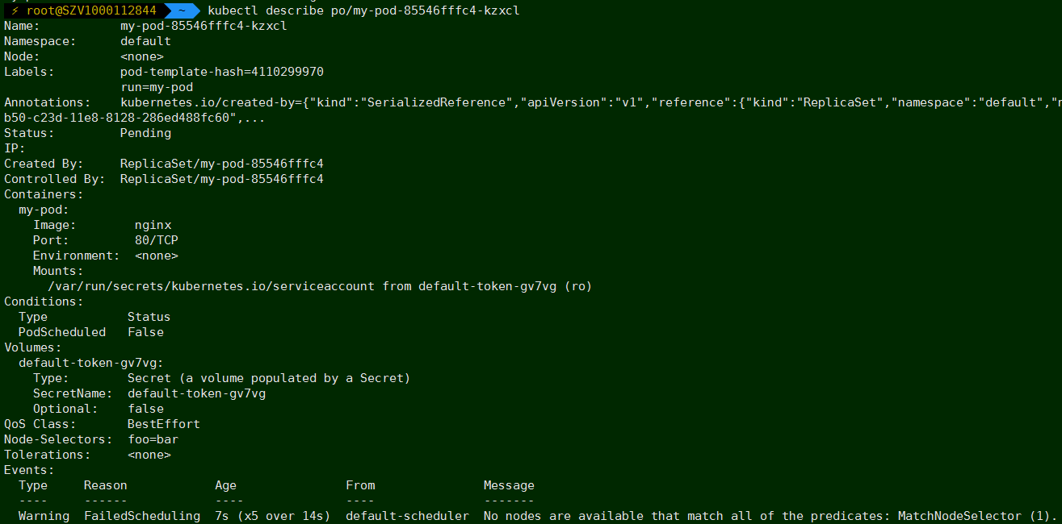
调度失败原因分析

Slide 24
多调度器及调度器配置

Slide 25
多调度器
apiVersion: v1
kind: Pod
metadata:
labels:
run: my-pod
name: my-pod
namespace: default
spec:
containers:
- image: nginx
imagePullPolicy: Always
name: my-pod
ports:
- containerPort: 80
protocol: TCP
schedulerName: my-custom-scheduler
适用场景：
集群中存在多个调度器，分别处理不同类型的作业调度
使用限制：
建议对node做资源池划分，避免调度结果写入冲突
使用scheduleName指定调度器

Slide 26
自定义调度器配置
--policy-config-file自定义调度器加载的算法，或者调整排序算法权重
{
"kind" : "Policy",
"apiVersion" : "v1",
"predicates" : [
{"name" : "PodFitsHostPorts"},
{"name" : "PodFitsResources"},
{"name" : "NoDiskConflict"},
{"name" : "NoVolumeZoneConflict"},
{"name" : "MatchNodeSelector"},
{"name" : "HostName"}
],
"priorities" : [
{"name" : "LeastRequestedPriority", "weight" : 1},
{"name" : "BalancedResourceAllocation", "weight" : 1},
{"name" : "ServiceSpreadingPriority", "weight" : 1},
{"name" : "EqualPriority", "weight" : 1}
],
"hardPodAffinitySymmetricWeight" : 10,
"alwaysCheckAllPredicates" : false
}
执行 kube-scheduler --help 查看更多调度器配置项

